Slide 1
Neural Networks for Regression: An Exploration of Activation Functions
Predicting California Housing Prices
Group Name/Members: UH ML - Hackaton Group 3/Atif Ahmed
Sana Amber
Sabthami Balasubramanian
Dunja Calianno
Akash Govardhane
Srilekha Pachaiyappan
Iffat Naeem Ali Shaikh
Mohammad Moaz Tahir
Date: 26/04/2026
Date: April 28th, 2026

Slide 2
Group Name/Members: UH ML - Hackaton Group 3/
Member 1 – Role - Atif Ahmed
Member 2 – Role - Sana Amber
Member 3 – Role - Sabthami Balasubramanian
Member 4 – Role - Dunja Calianno
Member 5 – Role - Akash Govardhane
Member 6 – Role - Srilekha Pachaiyappan
Member 7 – Role - Iffat Naeem Ali Shaikh
Member 8 - Role - Mohammad Moaz Tahir

Slide 3
Introduction & Problem Statement
Goal: Predict California housing prices using Neural Networks (NNs).
Key Question: How do different activation functions (ReLU, Sigmoid, Tanh) impact NN performance in regression tasks?
Approach: Build, train, and evaluate NNs with different activation functions to understand their effectiveness.

Slide 4
Dataset Overview - California Housing
Source: sklearn.datasets.fetch_california_housing
Target Variable: MEDV (Median House Value)
Features: Median Income, House Age, Average Rooms, Population, Latitude, Longitude, etc.
Snapshot of Data (First 5 Rows):
MedInc HouseAge AveRooms AveBedrms Population AveOccup Latitude \
0 8.3252 41.0 6.984127 1.023810 322.0 2.555556 37.88
1 8.3014 21.0 6.238137 0.971880 2401.0 2.109842 37.86
2 7.2574 52.0 8.288136 1.073446 496.0 2.802260 37.85
3 5.6431 52.0 5.817352 1.073059 558.0 2.547945 37.85
4 3.8462 52.0 6.281853 1.081081 565.0 2.181467 37.85
Longitude MedHouseVal MEDV
0 -122.23 4.526 4.526
1 -122.22 3.585 3.585
2 -122.24 3.521 3.521
3 -122.25 3.413 3.413
4 -122.25 3.422 3.422

Slide 5
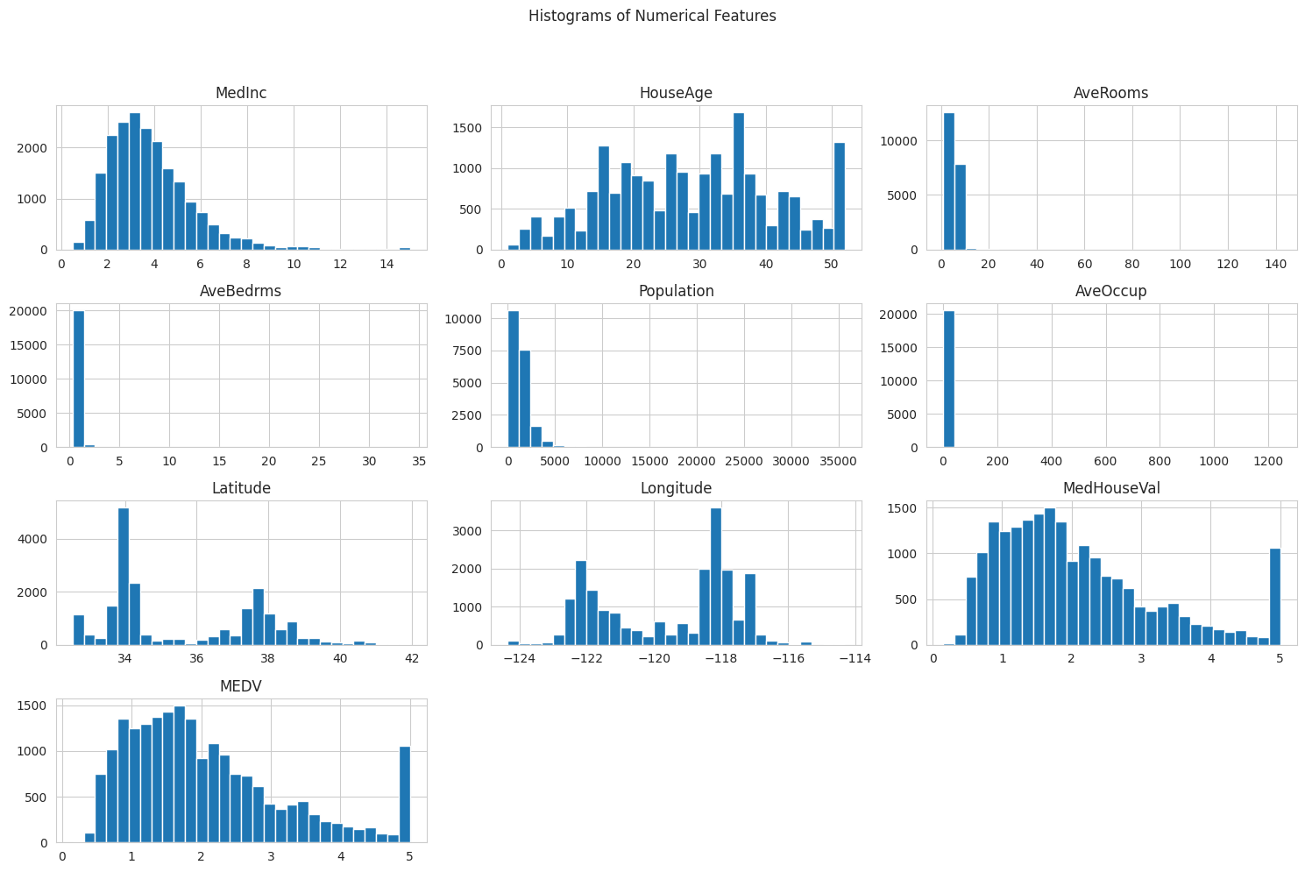
Exploratory Data Analysis (EDA) - Data Distribution
Histograms: Show the distribution of individual features. Most features exhibit skewed distributions.
Missing Values: No missing values were found in the dataset, ensuring data quality for modeling.

Slide 6
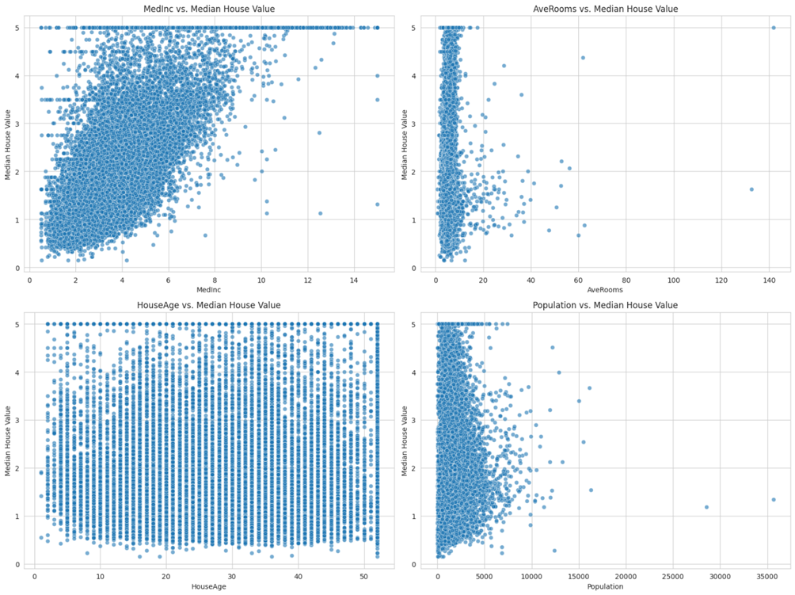
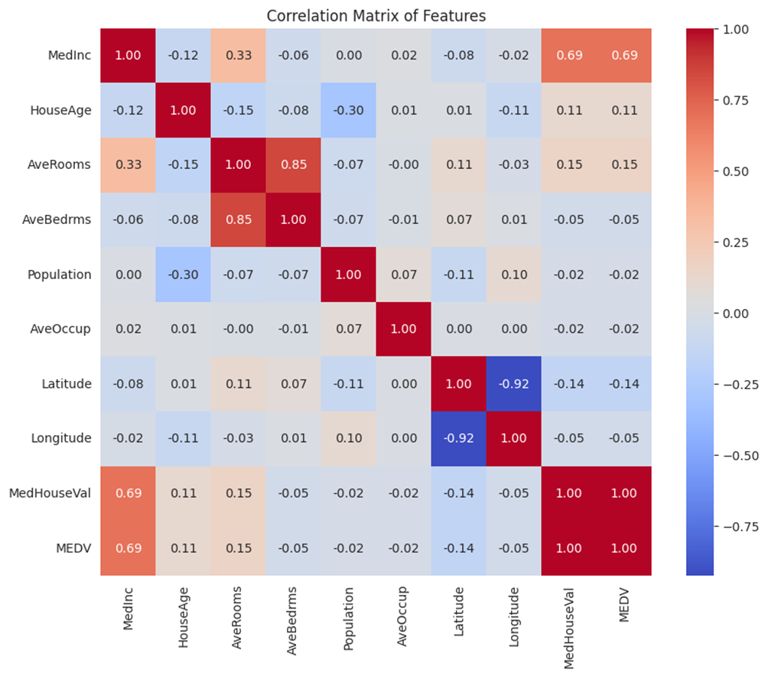
Exploratory Data Analysis (EDA) - Feature Relationships
Scatter Plots: Visualize relationships between key features and the target variable (MEDV).
Observation: MedInc (Median Income) shows a strong positive correlation with MEDV.
Correlation Matrix: Quantifies the linear relationships between all features.
Observation: MedInc and MedHouseVal are highly correlated with the target.

Slide 7
Data Preprocessing
Feature/Target Separation: X (features), y (target MEDV).
Train-Test Split: Data divided into 80% training set and 20% testing set (random_state=42).
Training set shape: (16512, 9)
Testing set shape: (4128, 9)
Feature Scaling (Standardization): Applied StandardScaler to X_train and X_test.
Why: Essential for Neural Networks to ensure features contribute equally and to speed up convergence.

Slide 8
Neural Network Architecture
Model Type: Simple Sequential Keras Model.
Layers:
Input Layer: layers.Dense(64, activation=activation_function, input_shape=(X_train_scaled.shape[1],))
Hidden Layer: layers.Dense(32, activation=activation_function)
Output Layer: layers.Dense(1) (for regression, linear activation by default)
Compilation:
Optimizer: adam
Loss Function: mean_squared_error
Metrics: mae, mse

Slide 9
Activation Functions Explored
We compared two common activation functions:
ReLU (Rectified Linear Unit):
f(x) = max(0, x)
Advantages: Helps mitigate the vanishing gradient problem, computationally efficient.
Use Case: Popular in hidden layers for deep learning.
Tanh (Hyperbolic Tangent):
f(x) = (e^x - e^-x) / (e^x + e^-x)
Advantages: Output centered at zero, which can help with optimization.
Disadvantages: Still suffers from vanishing gradients for very large/small inputs.

Slide 10
Model Training Process
Epochs: 100
Batch Size: 32
Validation Split: 20% of training data used for validation.
Loss History:
Observation: Both models show decreasing training and validation loss, indicating learning. ReLU appears to converge faster and to a lower loss.

Slide 11
Model Evaluation & Comparison
Performance Metrics:
Metric ReLU Model Tanh Model
0 MSE 0.000056 0.000243
1 RMSE 0.007503 0.015597
2 MAE 0.004946 0.012745
R2 Score 0.999957 0.999814
ReLU Model: Consistently outperforms the Tanh model across all metrics (lower MSE, RMSE, MAE; higher R2 Score).
Interpretation: The ReLU model provides significantly more accurate predictions for housing values.

Slide 12
Prediction Visualization
Actual vs. Predicted Values (ReLU Model)
Observation: The predictions align very closely with the actual values, clustering tightly around the ideal red dashed line. This visually confirms the high accuracy of the ReLU model.

Slide 13
Conclusion & Future Work
Conclusion:
Neural Networks are effective for regression on the California Housing dataset. The ReLU activation function demonstrably led to superior performance compared to Tanh in this setup.
Future Work:
Hyperparameter tuning (e.g., learning rate, number of layers/neurons).
Exploring more complex network architectures.
Investigating other activation functions (e.g., Leaky ReLU, ELU).
Cross-validation for more robust evaluation.
Thank You & Q & A

